Slide 1
CSCI 3412 Algorithms
Module 2: Introduction to Python Part I

Slide 2
Why Python?
History, Language Characteristics, Installation, Tutorials, …

Slide 3

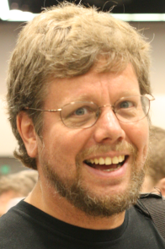
What is ? (source: wikipedia)
Conceived in the late 1980s by Guido Van Rossum in the Netherlands and born in 1991
Python and the Future of Programming | Lex Fridman Podcast #341
Characteristics:
high-level,
interpreted,
general-purpose programming language.
Design philosophy emphasizes:
Code readability with its notable use of significant whitespace.
Aim to help programmers write clear, logical code for small and large-scale projects.
Language specifics:
Dynamically typed
Garbage-collected
Supports multiple programming paradigms, including procedural, object-oriented, and functional programming.
Often described as a "batteries included" language due to its comprehensive standard built-in library.

Slide 4

Why is bad?
Slow - interpreted
Dynamical type checking. (but how often does ‘wrong type’ bite you, though? ➔ Many strongly static typing typed languages allow passing null as any type anyway.)
Weak OOP specially in encapsulation
Approximation: inner functions or naming convention
2 languages – python2 vs python 3
Indentation carrying too much importance

Slide 5
Why So Popular Despite Being (Super) Slow?
Enhanced Productivity compared to C, C++, and Java :
Highly productive, offering a more concise and expressive
Accomplish tasks with less time, effort, and lines of code, leading to faster development cycles.
Companies benefit by optimizing their most valuable resource: employees. Python's simplicity means less time spent on coding, more on innovation.
User Experience and Performance:
End-users rarely notice Python’s slowness for regular business application
Can you truly distinguish the difference between 0.01 seconds and 0.001 seconds?
Indentation encourages good coding practices contributing to maintainable code.
Rich set of libraries and frameworks
Enabling developers to leverage pre-built solutions for various tasks.
This extensive ecosystem accelerates development, allowing teams to focus on solving specific problems rather than reinventing the wheel
Large and active development community – collective knowledge

Slide 6
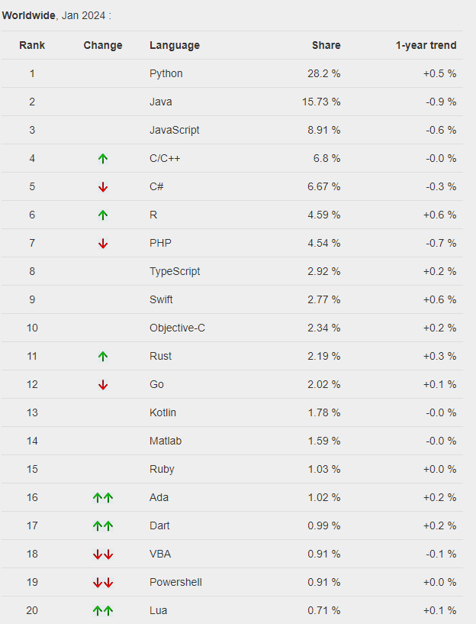
Popularity of Programming Language
The PYPL (Popularity of Programming Language Index) is created by analyzing how often language tutorials are searched on Google.
http://pypl.github.io/PYPL.html
Worldwide. Jan 2024 compared to a year ago:

Slide 7
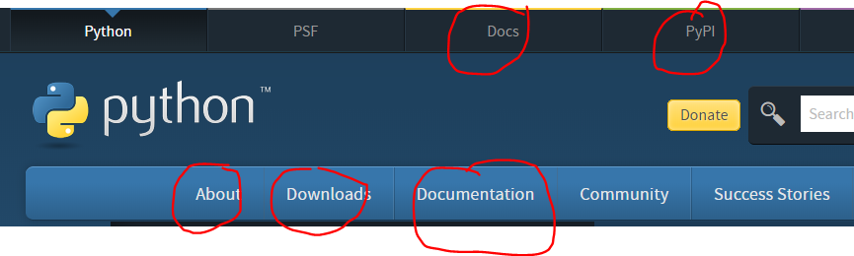
Installation & Documentation
Google “Python xxx”
Some popular sites:
https://www.python.org/, https://docs.python.org/3/tutorial/index.html
Youtube tutorials:
Python in 45 minutes for programmers: https://www.youtube.com/watch?v=N4mEzFDjqtA
https://www.youtube.com/watch?v=rfscVS0vtbw (4.5 hours)
Python for everyone: https://www.youtube.com/watch?v=8DvywoWv6fI
Google “python anaconda” to install Python3 and Jupyter notebook
Google “python free IDE (editor)”
Google “python PEP(Python Enhancement Proposal) 8 -- Style Guide for Python Code”

Slide 8
Some Python tidbits
“PEP: Python Enhancement Proposal, a design doc providing info to the Python community, or describing a new feature for Python or its processes or environment.”
The must-read Python’s PEPs:
PEP 20 – The Zen of Python: that’s the first PEP you need to read and apply throughout your Python development
PEP 8 – Style Guide for Python Code: this PEP defines the coding convention when writing Python. I expect everyone writing PEP8 compliant code
PEP 257 – Docstring Conventions: conventions for Docstring in Python
Some Easter Eggs:
import __hello__
import this #Zen of Python
import antigravity
from __future__ import braces #^^
…

Slide 9
import this
The Zen of Python, by Tim Peters
Beautiful is better than ugly. Explicit is better than implicit. Simple is better than complex. Complex is better than complicated. Flat is better than nested. Sparse is better than dense. Readability counts. Special cases aren't special enough to break the rules. Although practicality beats purity. Errors should never pass silently. Unless explicitly silenced. In the face of ambiguity, refuse the temptation to guess. There should be one-- and preferably only one --obvious way to do it. Although that way may not be obvious at first unless you're Dutch. Now is better than never. Although never is often better than *right* now. If the implementation is hard to explain, it's a bad idea. If the implementation is easy to explain, it may be a good idea. Namespaces are one honking great idea -- let's do more of those!

Slide 10
Programming in Python
Keywords, Types, dynamic type, expressions, dynamic binding, comments, arithmetic operations

Slide 11
Reserved Words
Python reserved (key)words
False None True and as assert asynce await break class continue
return def del elif else except finally for from global if import in is
lambda nonlocal not or pass raise return try while with yield
Reserved Words/Keywords vs Predefined Identifiers:
Reserved words(≈ keywords): Can’t be redefined as other identifiers
Predefined identifiers: has a predefined meaning in Python language but they can be redefined in your program
help(″keywords″)
# ‘int’ is a predefined identifier but not a reserved word
int = “Hello”
print (type(int))

Slide 12
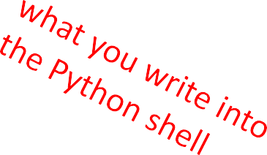
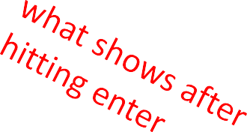
Scalar (Primitive) Types
int – represent integers, ex. 5
float – represent real numbers, ex. 3.27(double precision), no double type
bool – represent boolean values True and False
None – special and has one value, None
can use type()to see the type of an object
>>> | type(10)
int
>>> type(10.0) float

Slide 13
Type Conversions
Type Conversion: convert object of one type to another
Two types of type Conversion: Type casting vs. Type coercion
Type Casting: explicit conversion, specify the desired conversion using built-in functions.
float(3) converts integer 3 to float 3.0 (no double type)
int(3.9) truncates float 3.9 to integer 3
Type Coercion: implicit conversion, automatically performs necessary conversions to make expressions valid
Coercion: type(3.0 + 1)

Slide 14
Dynamically Typed Language
Aspect | Statically Typed Language | Dynamically Typed Language
Type Declaration | Identifiers must have their data types declared explicitly. | Identifiers may not require explicit type declarations.
Type Checking | Type checking is done at compile-time. Type errors are caught at compile-time. | Type is bound at runtime from the assigned objects. Type errors are often caught at runtime.
Type Flexibility | Type of an Identifier is fixed once declared. It can be bound to objects of the same type only. | Type of an Identifier can change during runtime.
Code Safety | Generally, more code-safe due to early type checking. | May lead to unexpected runtime errors. (Type undefined)
Development Speed vs. Type Safety | Favorable for type safety but may slow down development. | Allows for faster development but can introduce type-related issues.
Examples | C, C++, Java, Rust, Go | Python, JavaScript, Ruby, PHP

Slide 15
Yet, Type Matters at Runtime
Python knows what “type” every object is (at run time)
Some operations are prohibited
e.g., You cannot “add 1” to a string
Using type() function to check the type of the object.
Python is a Strongly Typed language
>>> eee = 'hello ' + 'there'
>>> eee = eee + 1
Traceback (most recent call last): File "<stdin>", line 1, in <module>TypeError: Can't convert 'int' object to str implicitly
>>> type(eee)
<class'str'>
>>> type('hello')
<class'str'>
>>> type(1)
<class'int'>
>>>

Slide 16
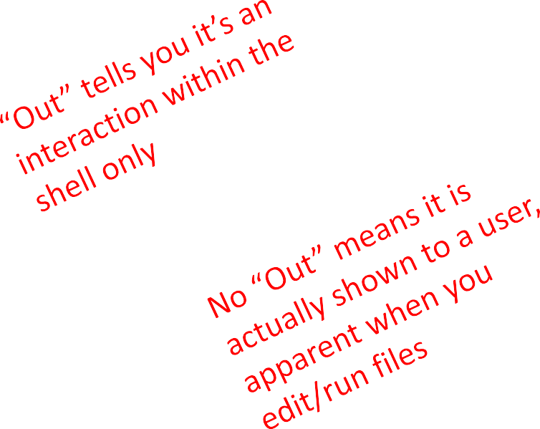
Printing to Console
16
To show output from code to a user, use print
Command (using Jupyter)
In [11]: 3+2
Out[11]: 5
In [12]: print(3+2)
5

Slide 17
Expressions
Combine objects and operators to form expressions
An expression returns a value, which has a type
Syntax for a simple expression
<object> <operator> <object>
Expression vs. Statement

Slide 18
Operators on ints and floats
i+j
i-j
i*j
i/j
i//j
→ the sum
→ the difference
→ the product
→ Division
→ Divide and return quotient
if both are ints, result is int
if either or both are floats, result is float
result is float (3/2 → 1.5, not 1)
result is integer (3/2 → 1)
i%j→ Remainder when i is divided by j(modulo op)
i**j → i to the power of j

Slide 19
Simple Operations
parentheses used
operator precedence
**
*
/
◦ + and – executed left to right, as appear in expression
Parenthesis, Power, Multiplication, Addition,
Left to Right
3 + (1 + 2)** 3 / 9 * 5 ➔ 18.0

Slide 20

Changing Bindings
Assignment statements re-bind variable names
Previous value may still be stored in memory but lost the handle for it
Value for area does not change until you tell the computer to do the calculation again
“;” is not needed at the end of statement
pi = 3.14
radius = 2.2
print(id(radius), radius)
area = pi*(radius**2)
radius = radius+1
print(id(radius), radius)
3.14
pi
radius area
2.2
3.2
15.1976

Slide 21
Comments in Python
Anything after a # is ignored by Python:
# Get the name of the file and open it
name = input('Enter file:')
handle = open(name, 'r')
# Count word frequency
counts = dict()
…
# Find the most common word
bigcount = None
bigword = None
…
# All done – prints out
print(bigword, bigcount)

Slide 22
Doc string (Documentation Convention)
PEP 257: https://www.python.org/dev/peps/pep-0257/
Python documentation strings (or docstrings) provide a convenient way of associating documentation with Python modules, functions, classes, and methods. (like Javadoc)
triple (quote or double quotes)
What should a docstring look like?
The doc string line should begin with a capital letter and end with a period.
The first line should be a short description.
If there are more lines in the documentation string, the second line should be blank, visually separating the summary from the rest of the description.
The following lines should be one or more paragraphs describing the object’s calling conventions, its side effects, etc
Accessing Docstrings: The docstrings can be accessed using the __doc__ of the object or using the help(identifier) function.
Notes:
print(dir(str))
print(str.__doc__)
help("str")

Slide 23
String (str)
Letters, special characters, spaces, digits
Enclosed in quotation marks or single quotes
hi = "hello there"
bye ='bye' #single quote
Concatenate strings
name = "ana's" //No escape sequence is needed
greet = hi + name
greeting = hi + " " + name
Do some operations on a string as defined in Python docs
silly = hi + " " + name * 3
Advanced topics: Important but will not cover in this class
String Formatting (f" string)
Unicode (Character set standard), UTF-8 and UTF-16 (encoding) for I18N (localization)

Slide 24
Language Controls
Input/output, boolean operation, conditional statements, looping statements, strings

Slide 25
INPUT / OUTPUT: print()
Displaying variable contents to the console
Use print() function
x = 1
print(x)
x_str = str(x)
print("my fav num is", x, ".","x =", x)
The full syntax of print() is:
print(*objects, sep = " ", end = "\n", file = sys.stdout, flush=false)

Slide 26
INPUT/OUTPUT: input("")
Prints whatever is in the quotes
User types in something and hits enter
Binds that value to a variable
text = input("Type anything... ") print(5*text)
Input() returns a string so you must cast if working with numbers:
num = int(input("Type a number... ")) print(5*num)

Slide 27
Comparison Operators
i and j are variable names
comparisons below evaluate to a Boolean value
i < j
i > j
i <= j
i == j equality test,
i != j inequality test,

Slide 28
Logic Operators on bools
a and b are variable names (with Boolean values)
not a
a and b
a or b
True if a is False False if a is True
True if both are True
True if either or both are True
a | b | a and b | a or b
True | True | True | True
True | False | False | True
False | True | False | True
False | False | False | False

Slide 29
Short Circuit Example
#A short circuit usage
s="abcx"
i = int(input("Enter the index:"))
if i < abs(len(s)) and s[i] == 'x’: # a guard against invalid index values
print(f"Correct answer:{s[i]}")
else:
print("Index out of bound or a wrong answer")
Short circuit evaluation: the second argument is executed or evaluated only if the first argument does not suffice to determine the value of the expression

Slide 30
Control Flow - Branching
if <condition>:
<expression>
<expression>
...
if <condition>:
<expression>
<expression>
...
elif <condition>:
<expression>
<expression>
...
else:
<expression>
<expression>
...
if <condition>:
<expression>
<expression>
...
else:
<expression>
<expression>
...
<condition> has a boolean value
Evaluate expressions in that block if <condition> is True

Slide 31
Indentation
Indentation matters in Python
“:”” matters
Watch out for TAB-expansion vs blanks
How you denote blocks of code:
x = float(input("Enter a number for x: "))
y = float(input("Enter a number for y: "))
if x == y:
print("x and y are equal")
if y != 0:
print("therefore, x / y is", x/y)
elif x < y:
print("x is smaller“)
else:
print("y is smaller")
print("thanks!")

Slide 32
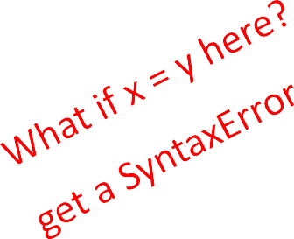
= vs ==
x = float(input("Enter a number for x: "))
y = float(input("Enter a number for y: "))
if x == y:
print("x and y are equal") if y != 0:
print("therefore, x / y is", x/y) elif x < y:
print("x is smaller") else:
print("y is smaller") print("thanks!")

Slide 33
Control flow: while Loops
while <condition>:
<expression>
<expression>
...
<condition> evaluates to a Boolean
if <condition> is True, do all the steps inside the while code block
check <condition> again
repeat until <condition> is False

Slide 34
Control flow: while and for Loops
Iterate through numbers in a sequence
# more complicated with while loop
n = 0
while n < 5:
print(n)
n = n+1
# shortcut with for loop
for n in range(5):
print(n)

Slide 35
Control flow : “for” Loop
for <variable> in range(<some_num>):
<expression>
<expression>
...
each time through the loop, <variable> takes a value
first time, <variable> starts at the initial value
next time, <variable> gets the prev value + 1

Slide 36
range(start = 0,stop, step = 1)
Default values are start=0 and step = 1 and they are optional
stop is required field
Loop until value is stop - 1
mysum = 0
for i in range(7, 10):
mysum += i
print(mysum) #24 = 7 + 8 + 9
mysum = 0
for i in range(5, 11, 2):
mysum += i
print(mysum) #21 = 5 + 7 + 9

Slide 37
break, continue Statement
break: Immediately exits whatever loop it is in
Skips remaining expressions in the code block
Exits only the innermost loop!
while <condition_1>:
while <condition_2>:
<expression_a>
break
<expression_b>
<expression_c>
continue: stop the current iteration of the loop, and continue with the next

Slide 38
for vs while Loop
for loops
know number of iterations
can end early via
break
uses a counter
while loops
unbounded number of iterations
can end early via break
can use a counter but must initialize before loop and increment it inside loop
may not be able to rewrite a while loop using a for loop
can rewrite a for
loop
using a while loop

Slide 39
Strings
Think of as a sequence of case sensitive characters
Can compare strings with ==, >, < etc.
len() is a built-in function used to retrieve the length of the string in the parentheses
s = "abc" len(s)
# evaluates to 3

Slide 40
Strings
Square brackets used to perform indexing into a string to get the value at a certain index/position
s = "abc"
index: index:
0 1 2 ← indexing always starts at 0
-3 -2 -1 ← last element always at index -1
s[0] | evaluates to "a" (str type)
s[1] | evaluates to "b"
s[2] | evaluates to "c"
s[3] | trying to index out of bounds, error
s[-1] | evaluates to "c"
s[-2] | evaluates to "b"
s[-3] | evaluates to "a"

Slide 41
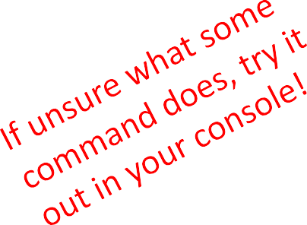
Strings
Can slice strings using [start:stop:step]
If two numbers, [start:stop], step=1 by default
you can also omit numbers and leave just colons
s = "abcdefgh"
s[3:6] evaluates to "def", same as s[3:6:1] s[3:6:2] → evaluates to "df"
s[::]
s[::-1]
→ evaluates to "abcdefgh", same as s[0:len(s):1]
→ evaluates to "hgfedcba", s[-1:-(len(s)+1):-1]

Slide 42

Strings
Unlike C++ but like Java, Python strings are “immutable”
s = "hello"
s[0] = 'y'
s = 'y'+s[1:len(s)]
→ gives an error
→ is allowed,
s bounds to new object, not updating the existing object
"hello"
"yello"
s

Slide 43
for Loops Recap
for loops have a loop variable that iterates over a set of values
for var in range(4):
<expressions>
→var iterates over values 0,1,2,3
→ expressions inside loop executed with each value for var
for var in range(4,6): →var iterates over values 4, 5
<expressions>
range() is a way to iterate over numbers, but a for-loop variable can iterate over any set of values, not just numbers!

Slide 44
Strings and Loops
these two code snippets do the same thing
bottom one is more “pythonic”
s = "abcdefgh"
for index in range(len(s)):
if s[index] == 'i' or s[index] == 'u': print("There is an i or u")
for | char in s:
 | if char == 'i' or char print("There is an | == 'u': i or u")

Slide 45
Code Example:
Robot Cheerleaders
i = 0
while i < len(word): char = word[i]
for char in word:
if char in an_letters:
print("Give me an " + char + "! " + char) else:
print("Give me a " + char + "! " + char) i += 1

Slide 46
Exercise
# displaying the common characters between two strings
s1 = "ucd u rock"
s2 = "i rule ucd"
if len(s1) == len(s2):
for char1 in s1:
for char2 in s2:
if char1 == char2:
print("common letter: ", char1)
break

